Slide 1
The Algorithm Animation Project
The design presentation
Conducted by Nur Aishah B M Senin

Slide 2
A brief description about the program
Show the different types of commonly used algorithms
From the 3 main algorithmic paradigms and sorting algorithms
Animations to show the essential pieces of the puzzle that makes the algorithm works as a whole
Enables user to “control” the animation
Program is run on a WPF application, which predominantly runs on Windows operating systems (from Windows 7 onwards)

Slide 3
The purpose of the Algorithm Animation Program
Provide a better understanding on how algorithms work in general
For the benefit of users by allowing them to learn algorithms from a different perspective
An extra educational content that can be used aside from lectures
Target audience: Computer Science students or individuals who are interested in finding ways of making a program more efficient

Slide 4
Aims and objectives of this project
To understand the difficulties that are faced by students when it comes to this topic, and to overcome them
Breaking down difficult algorithmic problems into simpler forms
Allow greater understanding from our users
Serve this program as a foundation for developers alike

Slide 5
Design of the software

Slide 6
The contents of the program
A main menu
Settings feature
Animation feature

Slide 7
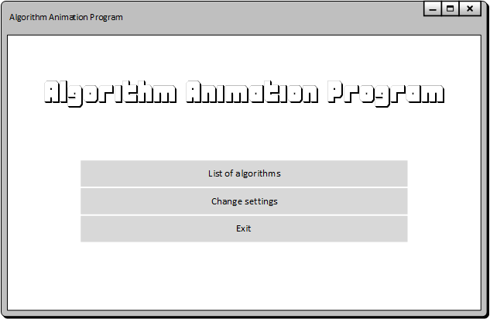
Main menu
To provide user navigation
Lists the selection of features for the user to select from
The simple UI design of the main menu

Slide 8
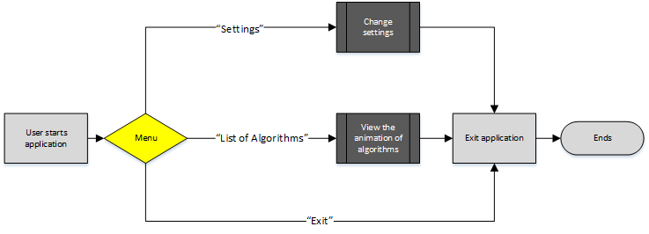
The flowchart that shows the overall view of the Algorithm Animation Program from the Main Menu

Slide 9
The settings feature
Allow users to change the settings
Changing the font size
Changing of the speed of the animation
Allows the user to work with ease in an environment where they are most comfortable working in
Aim is to make the settings feature to be easily implementable for other developers

Slide 10
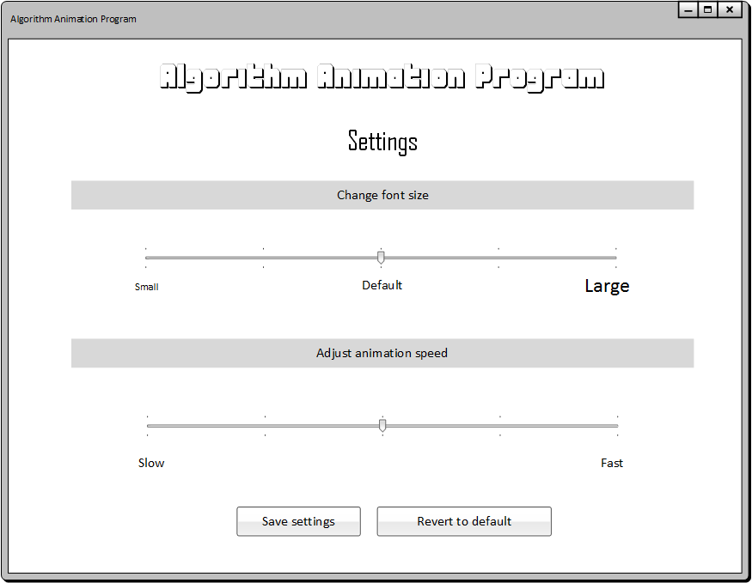
The UI design of the settings feature

Slide 11
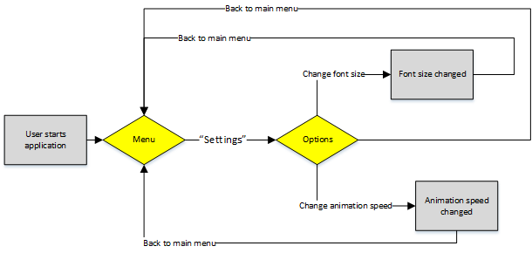
The flowchart of the settings feature

Slide 12
The animation feature
Main feature of this project
Shows the list of algorithms available for users to view
Input page
The animation page, and controls

Slide 13
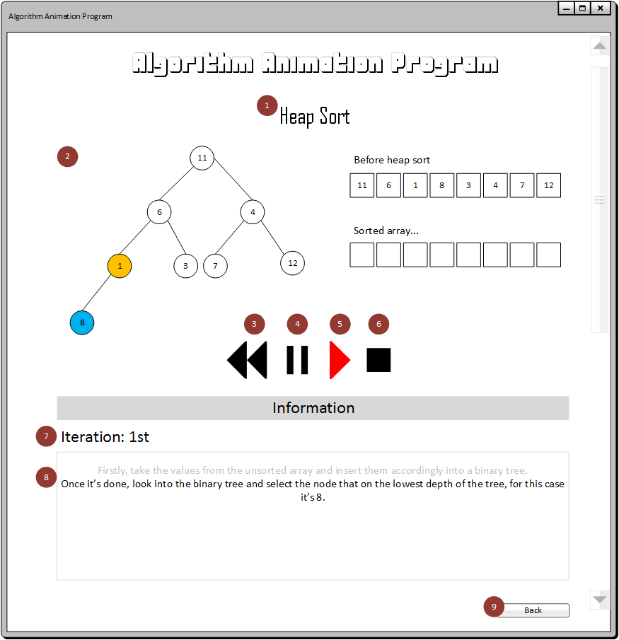

Slide 14
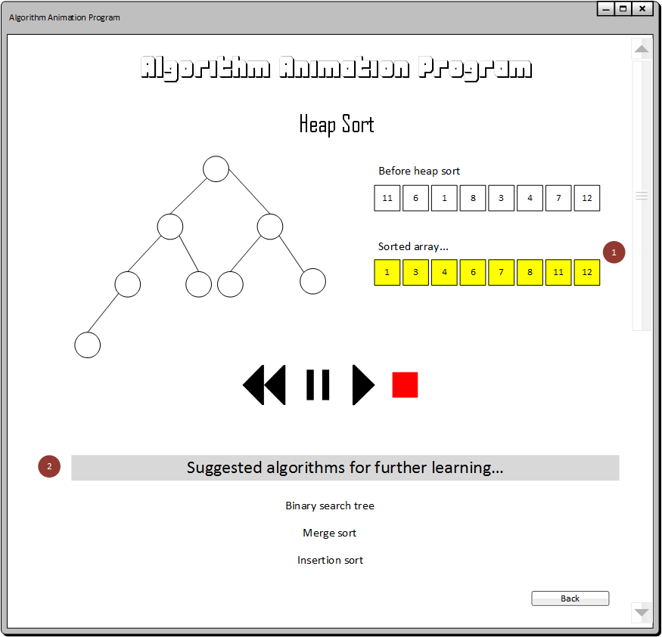

Slide 15
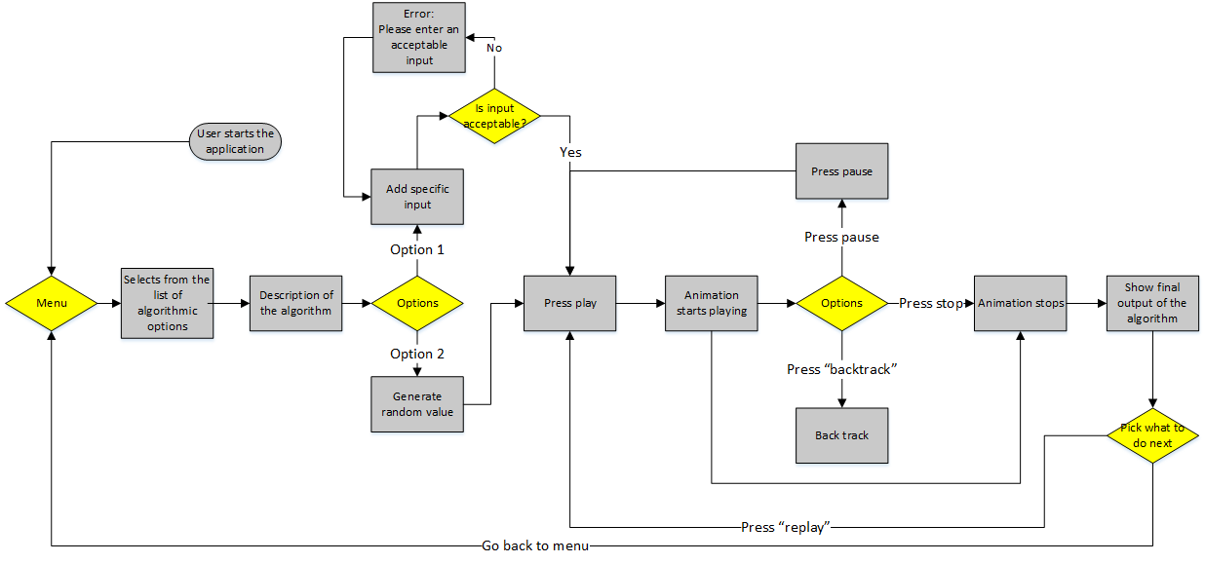

Slide 16
Design of the animations

Slide 17
The algorithms that will be included in the program…
Fractional Knapsack problem
Knapsack problem
Activity Selection problem
Matrix multiplication
Rod cutting problem
Bubble sort
Merge sort
Insertion sort

Slide 18
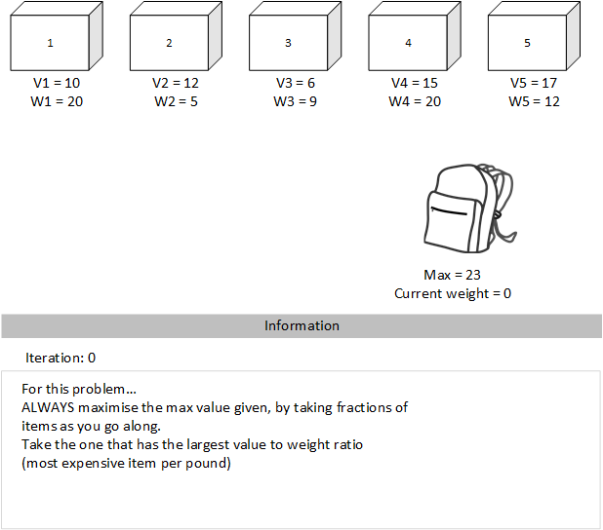
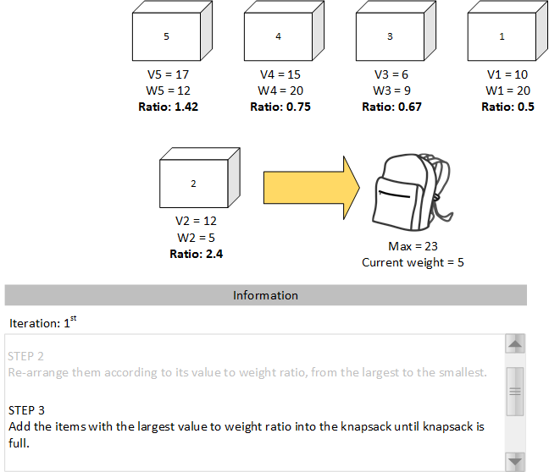
Fractional Knapsack Problem

Slide 19
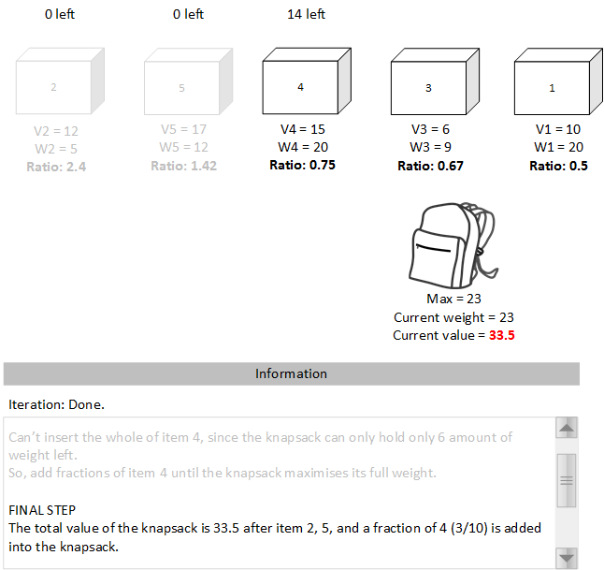

Slide 20
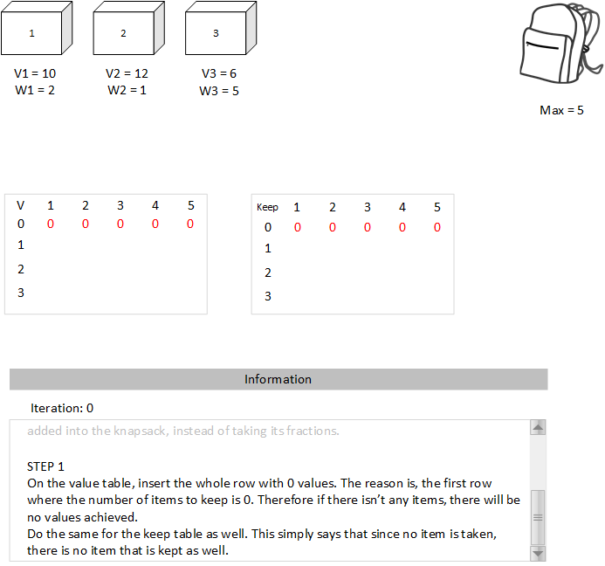
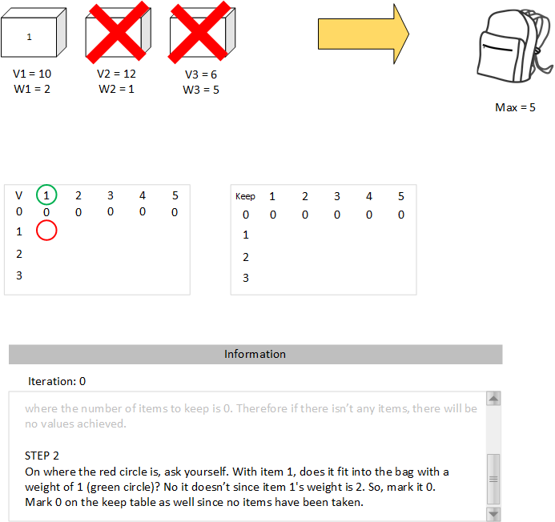
Knapsack Problem

Slide 21
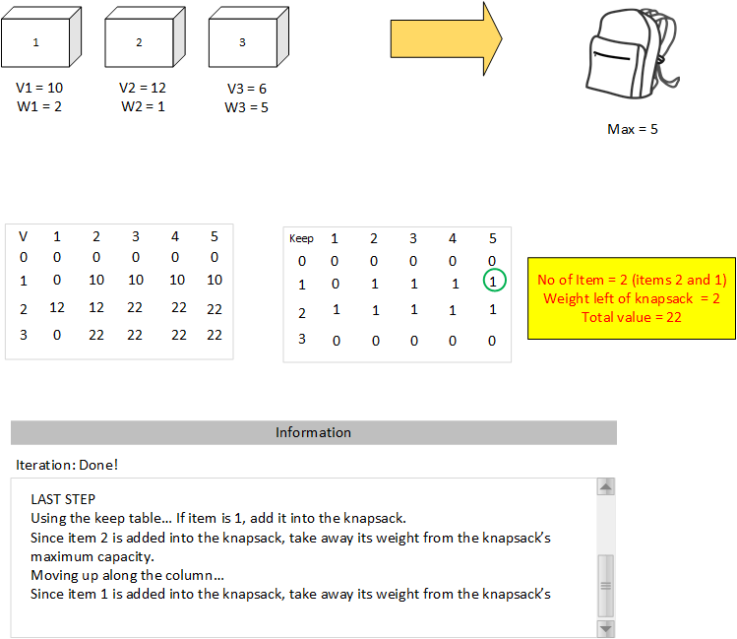

Slide 22
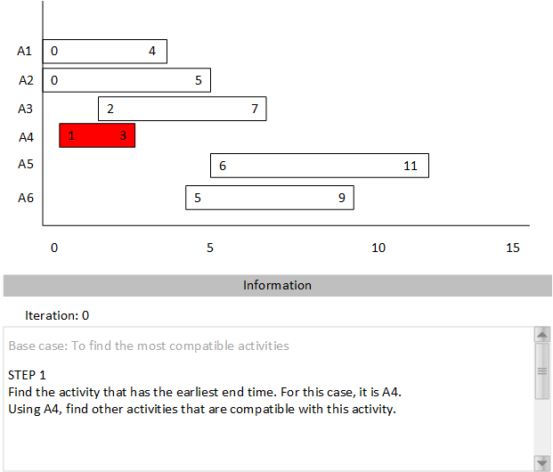
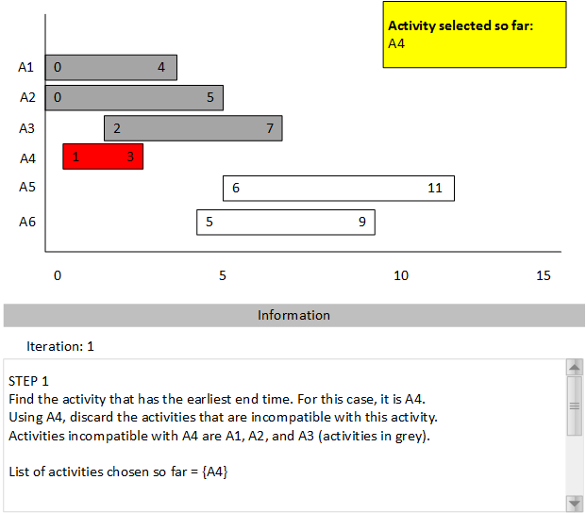
Activity Selection Problem

Slide 23
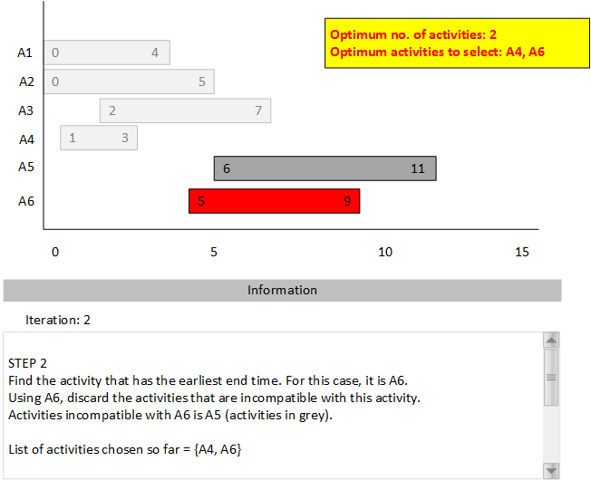
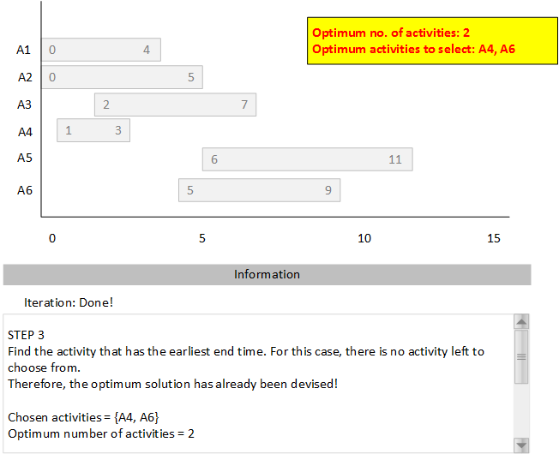

Slide 24
Evaluation design

Slide 25
The main criteria to assess during evaluation
Usability
Comprehensiveness
Correctness

Slide 26
The evaluation process
Testers are required to use the program
Assess the program based on criteria mentioned before
Filling up the feedback form

Slide 27
Changes that was made that deviates from the specification documentation
Removed several algorithms in order make time
Using of testers to conduct the evaluation of the program
Addition of the settings feature

